Slide 1

Introduction to Mobile Application
Dilman A. Salih
University of Halabja
Slides: 5,9,10,11,12,14,15 and 19.

Slide 2

Outline
What is Mobile Apps?
Technology in 21st century
Best Apps to Adopt !!!
Mobile Apps Development
Types of Mobile Apps
Mobile Apps Developing Model

Slide 3
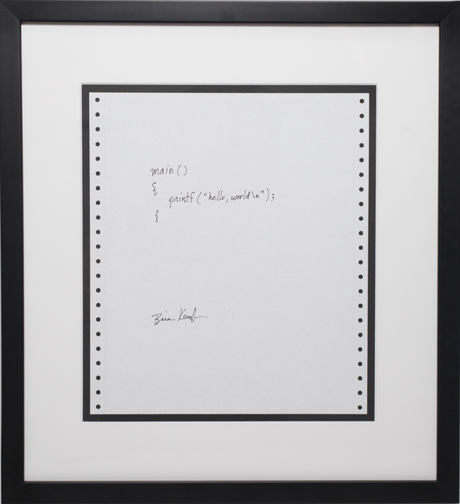
Computer Programs
A computer program is a collection of instructions that can be executed by a computer to perform a specific task. “Wikipedia”
“hello, world” computer program by Brian Kernighan (1978).

Slide 4

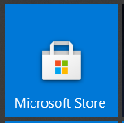
Desktop Applications
People used to talk about programs while discussing desktop operating systems like Windows. And they spoke about apps while discussing mobile OS like Android and iOS. Over the years, desktop apps surfaced to join them.
A Desktop app is a program or a collection of programs meant for the end user to perform a task or achieve a purpose.
Has UI.
Not separate Install (setup) and Uninstall files.
Example: Universal Windows Platform (UWP) apps.
Installed from Windows Store.
All apps are programs, but not all programs are necessarily apps.
Notes:
https://www.ghacks.net/2015/03/24/after-two-years-microsoft-makes-up-its-mind-how-to-call-windows-apps/
https://www.guidingtech.com/difference-between-app-program-windows/
https://docs.microsoft.com/en-us/windows/apps/desktop/choose-your-platform
A program needs an installer that already has a package consisting of necessary files. Also, it may download more files from the web before installing itself on your computer. An app, on the other hand, is a single file that you download and install on your computer. You don’t need a separate uninstaller to remove an app, unlike programs.
Programs are built to work on a single or a dedicated platform while apps are developed to work on more than one platform. We’re strictly referring to the Microsoft’s platforms beyond Windows. Apps run on all devices running Windows 10 including laptops, desktop PCs, the Xbox, Internet of Things and others while desktop programs are limited to PCs only.
An app is always built with the end user in mind to complete a single task or a set of functions with input from the user. A program can run in the background without user intervention.

Slide 5
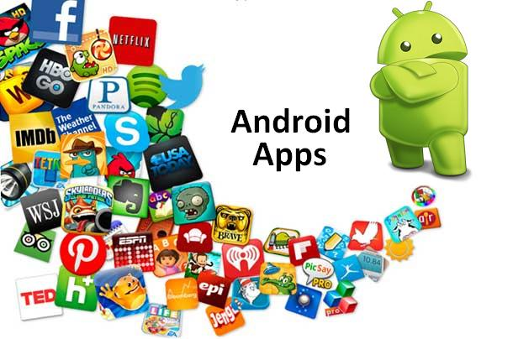
What is Mobile Apps?
A mobile application, also referred to as a mobile app or simply an app, is a computer program or software application designed to run on a mobile device such as a phone, tablet, or watch.
Apps that are not preinstalled are usually available through distribution platforms called app stores.
The three biggest app stores:
Google Play for Android.
App Store for iOS.
Microsoft Store for Windows 10, Windows 10 Mobile, and Xbox One.

Slide 6



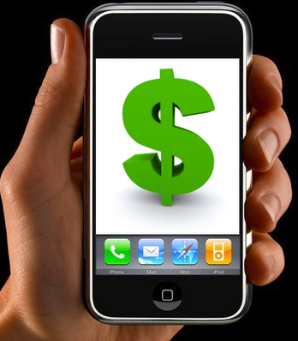
Why Mobile Apps?
Estimated smartphone users worldwide total 1.75 billion in 2014, which will grow to 5 billion by the middle of 2017.
Provide mobile phone users with apps that can keep them productive, informed, entertained, or connected whenever they feel the need
Large potential for financial gain in the field of mobile applications
Solve problems which have many challenges and obstacles

Slide 7


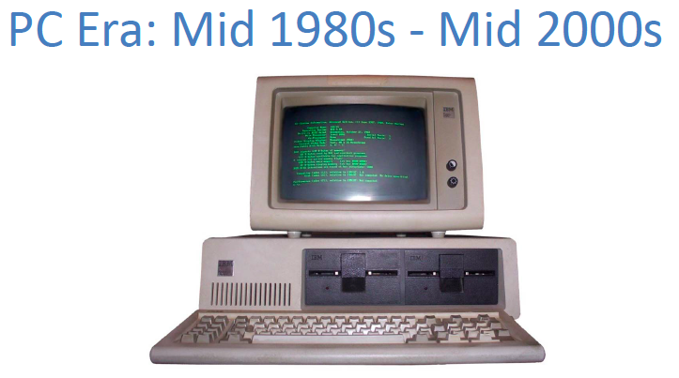
Technology in 21st century

Slide 8
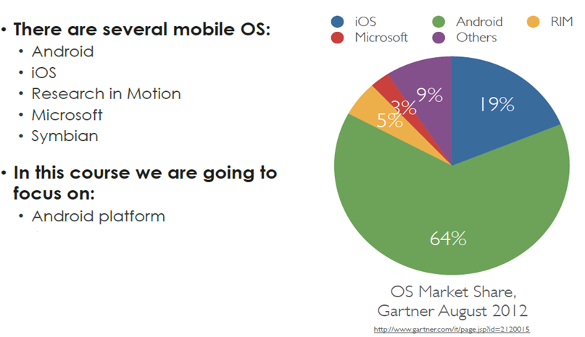
Best Apps to Adopt !!!

Slide 9
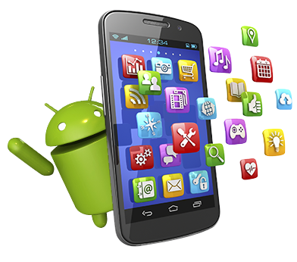
Types of Mobile Apps
1. Native Applications
Native applications are those applications that are installed on the device, such as Address Book, Calendar, Calculator, Games, Maps and Web Browser …etc.
These applications have their own runtime environment for execution.
Highly interactive applications are really only feasible when they are native applications

Slide 10
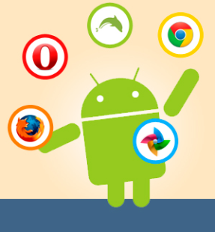
Types of Mobile Apps (2)
2. Browser-Based Applications
A Browser-Based application is an application that is accessed through the use of the mobile device’s web browser.
The Web app resides on server and is accessed via the Internet
Browser-Based applications are coded with the use of a Markup Language HTML, XML, CSS…etc

Slide 11
Types of Mobile Apps (3)
3. Hybrid Applications
A mix of native and web-based apps.
Apps developed using Apache Cordova, Xamarin, React Native, Sencha Touch and other similar technology fall into this category.
These are made to support web and native technologies across multiple platforms.
Easier and faster to develop.
It involves use of single code base which works in multiple mobile operating systems.
Despite such advantages, hybrid apps exhibit lower performance. Often, apps fail to bear the same look-and-feel in different mobile operating systems.

Slide 12
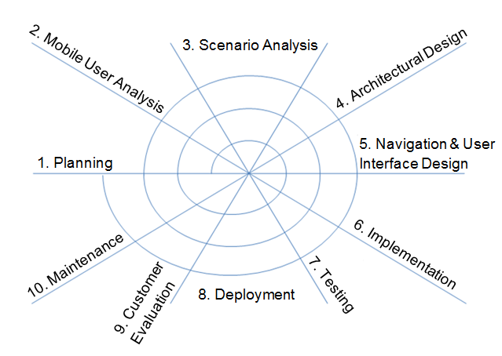
Mobile Apps Developing Model

Slide 13
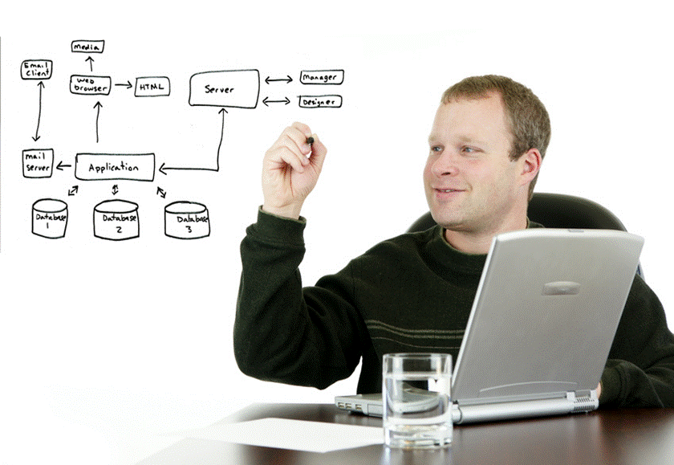

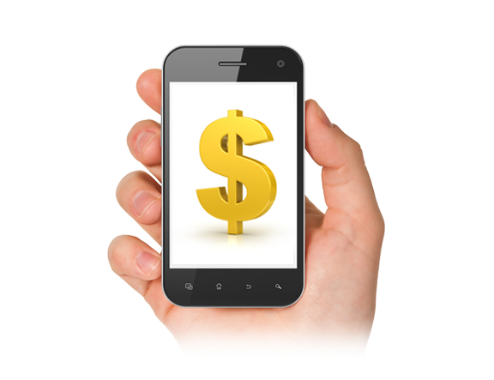
1. Planning
The planning phase deals with:
Identifying the objectives of the application
Specifying the scope of the first step
Estimating the possible cost of the project
Analyzing the possible risks involved
Creating a tentative schedule

Slide 14

2. Mobile User Analysis
This phase deals with understanding our target audience for the application
We need to examine the types of users that with use the application and any special requirements or functionality they require
We can gather information by:
asking experts in the field
reading literature on the topic
asking current users

Slide 15

3. Scenario Analysis
In this phase we focus on three areas:
1. Screen and Interaction Analysis
How the user will interact with the system, how content will be displayed
2. Usage Analysis
The functionality of the system, use cases should be considered to relay this information
3. Environment Analysis
The interaction between this system and other networks and devices

Slide 16
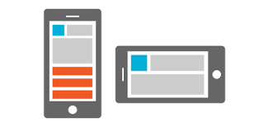

4. Architectural Design
This phase deals with the architecture of the system when dealing with network based applications
It should discuss how the system will be split and the challenges and benefits of such a design
As discussed, attention must be paid to message latency and application partitioning to ensure performance, reliability, and security

Slide 17

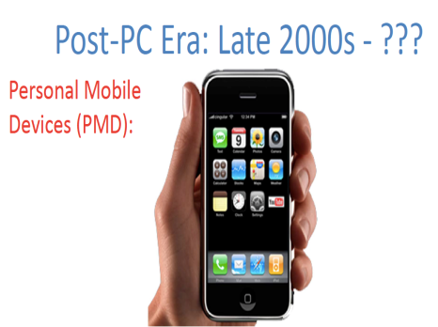
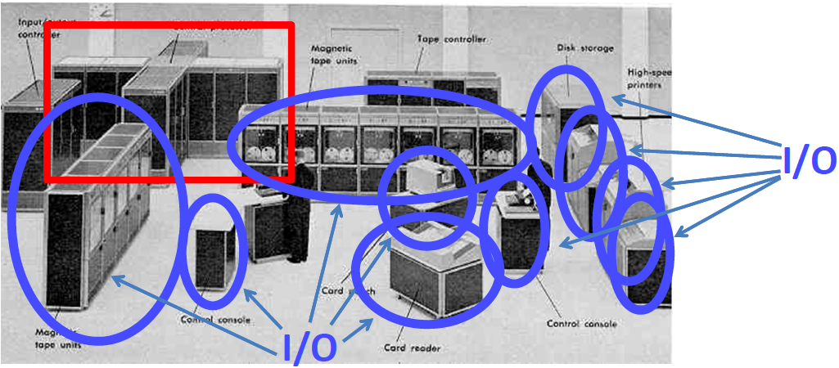
5. Navigation & User Interface Design

Slide 18
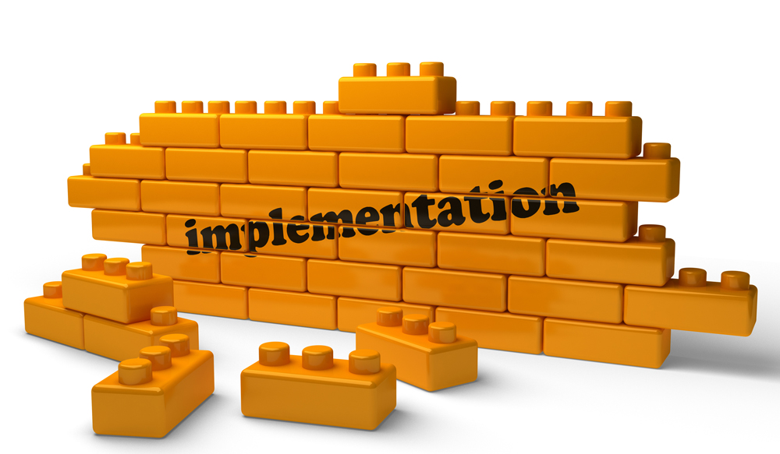
6. Implementation
Implementation of the application is done in this phase with the use of any number of development tools
Code Conventions, class and object diagrams, API specifications can all be included in any documentation that is created at this point for the system
This allows developers who join the project at later stages to follow the same format and style as the original authors

Slide 19
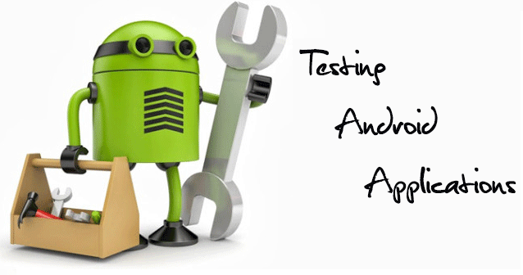
7. Testing
Testing is extremely important in mobile application development not only due to the heterogeneity of mobile devices
It is important to test not only in an emulator but on the physical device as well, and to test on all or as many physical devices as the application can be located
Testing also assists us to remove bugs and flaws in programs which become inevitable in larger systems as they become complex

Slide 20
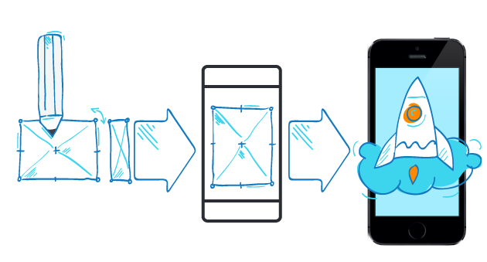
8. Deployment
Deployment of the application on physical devices will allow you to see the system in the real world
Applications may be fine in an emulator but when transferred to a mobile device developers may find the application slow, impossible to use, not functioning all together, or consuming too much bandwidth
It may not economically feasible to test on every possible device that a system may be used on but a wide variety of devices should be tested

Slide 21

9. Customer Evaluation
At this point the application is ready for download by customers in the network
Customers should be given a way of providing feedback to the developers and reporting any issues they encounter when using the application
Consider providing an email or web form where users can fill in the necessary information or provide an automated process which sends the error to the server

Slide 22
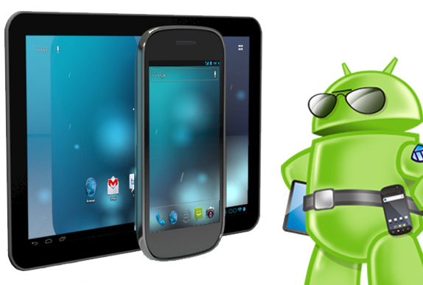
10. Maintenance
Maintenance of the system after deployment deals with several issues:
resolving any bugs found in the application and creating necessary patches
improving the quality of the application with upgrades
providing new services and capabilities to customers

Slide 23

Q & A

